Slide 1
Food Waste RNG Project Development
Avisen Legal – Renewable Energy Lawyers

Slide 2
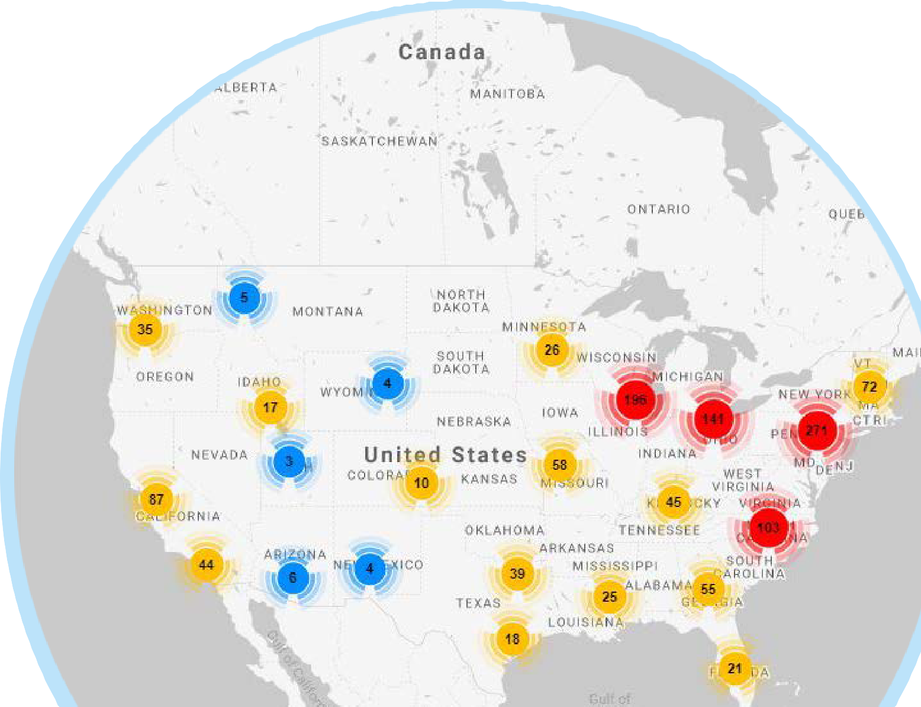
The US Biogas Market
15,000+
Potential New Biogas Systems
2,300
Operational Biogas Systems
Current
317 on Farm (+16%)
1,269 Wastewater
66 Food Scrap
645 at Landfills
200+
Operational RNG
Projects (+28%)
Potential 8,300 on Farm
4,000 Wastewater
1,000 Food Scrap
440 at Landfills
American Biogas Council
www.americanbiogascouncil.org

Slide 3
RNG potential

Slide 4
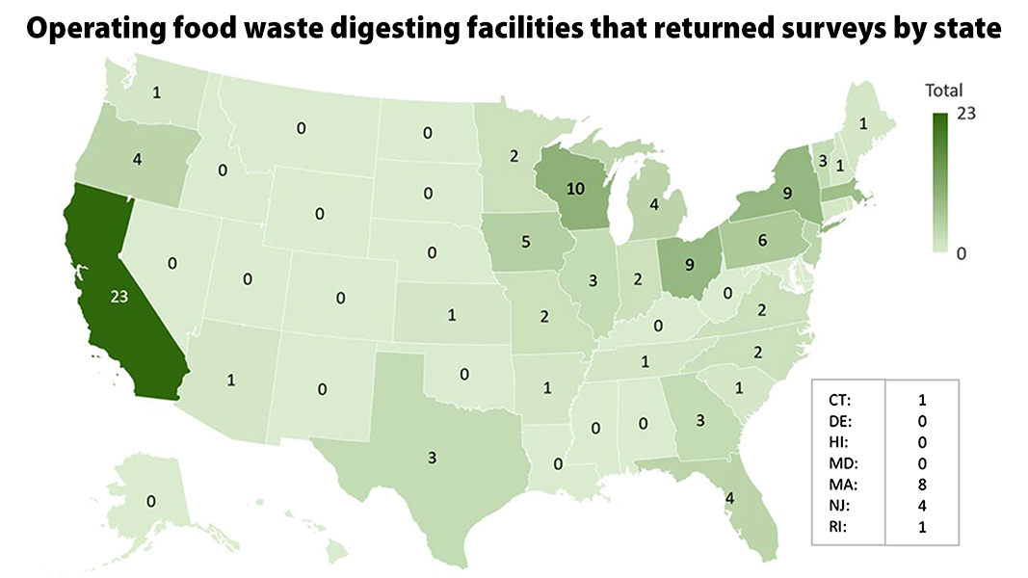
Existing Food waste digestors

Slide 5
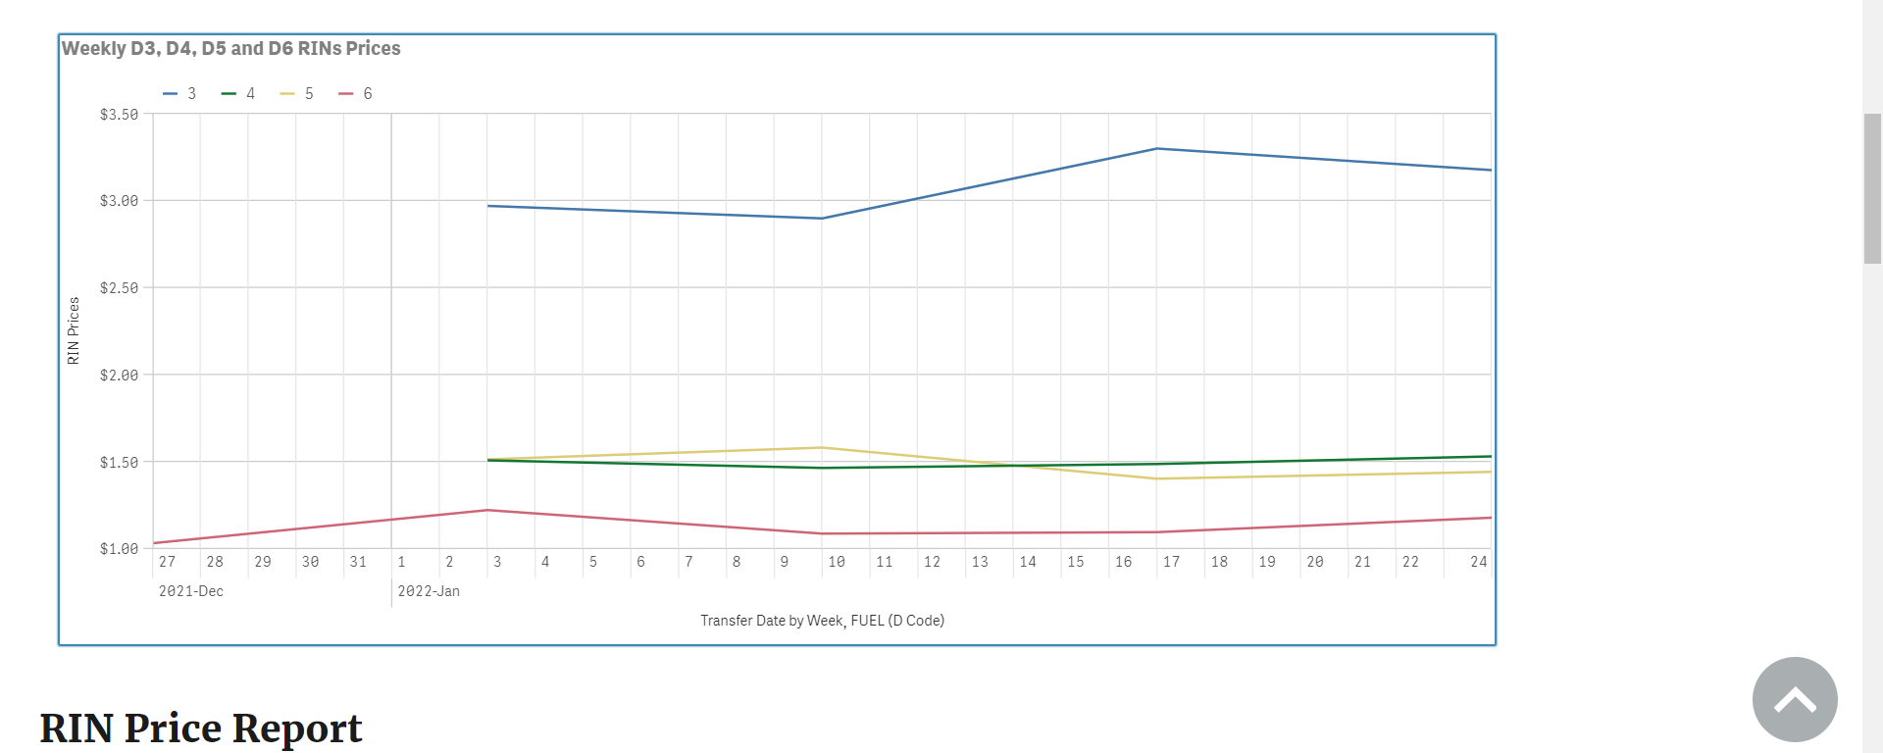
Value of Food Waste RNG
Most food waste systems will generate D5 RINs

Slide 6
LCFS Certified Pathways

Slide 7
LCFS Food Waste
LCFS breaks food waste into three groups:
Food Scraps, originally meant for human consumption
Urban Landscaping Waste, like lawn clippings, stumps
Other Organic Waste, likely includes industrial food processing and ag residue
California has over 60 current dairy to RNG pathways.
Guesses on how many food scrap, urban landscaping waste, other…?
Dairies score much lower on Carbon Intensity
-79 CI for food scraps
Worst Dairy CI?
Best Dairy CI?
Notes:
3 others
-135
-700

Slide 8
So why Food Waste?
Cost of Feedstock
Cost of ton of dairy manure?
Fixed fee
Tied to credits received
Cost of ton of food waste?
Often paid a tipping fee to take
Organics diversion laws require if available
Increasing regulatory focus on landfills and food waste
New York changed its constitution to include environmental protections…within a week two major landfills sued.

Slide 9
Food Waste Economics

Slide 10
Keys to successful Food Waste Project
Right Technology
Right Feedstock Providers
Right EPC Contractor
Right Offtake
Right Financing

Slide 11
Right Technology
Must be proven to work with food waste and/or mixed feedstock
Must provide performance guarantee
Must be financially able to support guarantee or obtain insurance
Must provide start-up and as needed support
Must work with EPC contractor
Must work with Feedstock providers

Slide 12
Right Feedstock Provider
Long-term food waste feedstock contracts uncommon and mostly unknown.
Problem for project financing
Must ensure that the delivered food waste works with technology and pre-treatment systems
Must ensure that the feedstock works with any permitting requirements
Ensure start up delivery schedule
Penalties for failure to deliver

Slide 13
Right EPC Contractor
Experience with biogas construction
Experience with food waste preferred
Clear description of Scope of Work
Liquidated Damages for Delays (may be required for project financing)
Financial strength or surety bond

Slide 14
Right Offtake
Interconnection
Pipeline
Electricity
Right of ways and permitting
Electricity sales
ITC
e-RINs
Gas
Gas itself
RINs
LCFS

Slide 15
Right Financing
Development stage
Funding for permits, engineering, site selection, experts
Often from project developers themselves
Friends, family, angel investors
Professional development stage financiers
Project Equity
Funding for the equity portion of the project
Family offices, infrastructure and impact funds
Large community raise
Project Debt
Funding the rest of the project costs
Ag related banks and USDA loan guarantees
Sustainability focused lenders
Export (technology) lenders and guarantees

Slide 16
Practical, entrepreneurial lawyers
Over 20 years working with developers, equity partners, funds, lenders, construction and technology providers
Todd Taylor
612 325 5036
ttaylor@avisenlegal.com
www.avisenlegal.com

