Slide 1

The Cow Jumped over the Digester – Getting a Dairy RNG Project Financed
Avisen Legal – Renewable Energy Lawyers

Slide 2


Slide 3
The Developers Dilemma
Great Idea
Great Location
Great Technology
Great Team
…No Money
  Can’t afford permitting
  Can’t afford preliminary engineering
  Can’t afford experts…Mark is expensive!

Slide 4
The Solution?
Ask family, Grandma loves you
Ask all your friends for money
Ask all their friends
Email and Text everyone
Post on LinkedIn, Facebook, Twitter, Instagram, Tik Tok, Twitch and Discord
Hold public investing events in local area

Slide 5
The Problem with the Solution
Federal and State law restrict who can invest and how you can ask
Done wrong,
  SEC and states can force you to offer to give everyone their money back, with interest
  Investors can demand their money back, with interest, plus their lawyers’ fees
  SEC and states can fine and even stop you from trying again.

Slide 6
Real Solutions
Every offer and sale of stock, LLC units, promissory notes, convertible notes, SAFEs, etc (defined as a “security” under federal and state laws) is regulated.
Must either be registered or exempt.
Registered means an IPO, a SPAC, Public Shell Merger
Exempt means Crowdfunding, Regulation D, Regulation A
Must meet requirements of both Federal and State rules…do not always match up

Slide 7
Exemption Offerings
More money raised in exempt offerings than registered offerings, no matter how much hype you hear around SPACs.
Exempt offerings limit one of more of the following:
  Wealth/income of investors
  Advertising to find investors
  Number of investors

Slide 8
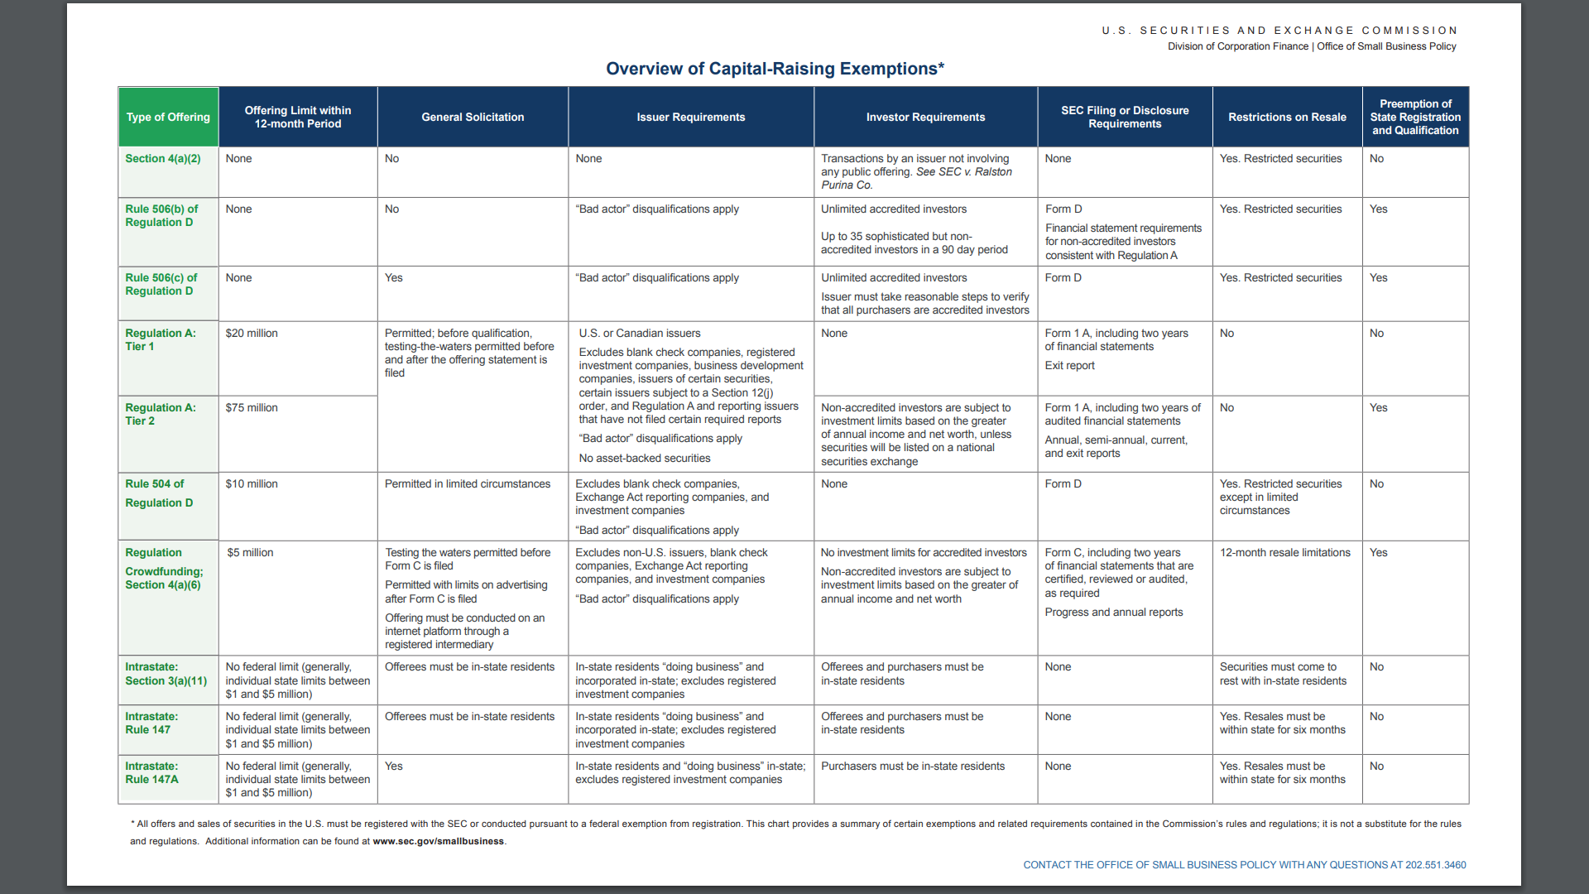
Exempt Offerings

Slide 9
Exempt Offerings
Rule 506(b) by far the most used. Only accredited investors and no advertising. Over 90% of all offerings.
Crowdfunding works only if you can find the crowd. Not always easy.
Regulation A also needs a crowd and has a lot of information requirements.
Intrastate offerings only investors and business in state…but was used successfully by a lot of ethanol plants

Slide 10
Registered Offerings
IPOs, SPACs, Shell/Reverse Mergers
Expensive and time-consuming
Reliant on market conditions
Much more scrutiny about business plans and financials
Can be worthwhile if business already established and looking for bigger money to grow
SPACs aren’t dead but the SPAC craze is over, having generally failed

Slide 11
Offering Materials
Most exempt offerings require some business and financial disclosure to investors
More required with non-accredited investors
No requirement under the rule for most all accredited exemptions (506, 4(a)(2). None required for 504, even though it allows non-accredited investors
Registered offerings, crowdfunding and Regulation A all require certain information, including ongoing reporting

Slide 13
Practical, entrepreneurial lawyers
Over 20 years working with developers, equity partners, funds, lenders, construction and technology providers
Todd Taylor
612 325 5036
ttaylor@avisenlegal.com
www.avisenlegal.com

Slide 14



